Slide 1
Newport City Council
Improving www.newport.gov.uk
Matthew Peters
E-access Development Officer, Newport City Council

Slide 2
June 2012
Notes:
I’d like to start by showing where we were at the start of the project.
Here was our homepage. The site was generally pretty good; 3 stars in SOCITM better connected
We’d been adding more and more online services to the sites (pay, apply, report etc), but the site still felt like it was stuck in the days when a website was there to push informaion rather than as a serious customer services channel

Slide 3
June 2012
Very “marketing and comms” oriented
Notes:
As you can see, the homepage was more information based than task based. That big red bit is the news, events and promotional stuff. We had managed to sneak a “top tasks” list onto the homepage which is just squeezed in on the right

Slide 4
Analysing our site
Notes:
The first thing we did was look at the data we had on how people were using the site

Slide 5
Heatmaps & Scrollmaps
Crazy Egg
Target chosen pages
Where do people click?
How far do they scroll down the page?
Notes:
We used a service called Crazy Egg which essentially tracks mouse events on a chosen set of pages.
From recording the mouse clicks, it can generate a heatmap showing the areas and links which have received the most clicks
So we can it on our homepage for a month and this was the result

Slide 6
Notes:
Just comparing to the graphic we showed earlier, ou can see a cluster of activity on the search box, some activity on the main navigation features and a big white bit on that popular pages list on the right.
Meanwhile, the news, events, promotional items barely registered

Slide 7
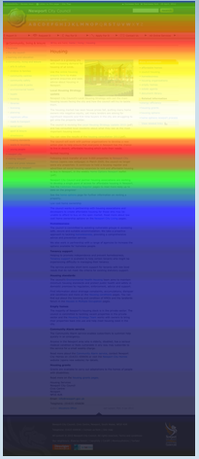
Notes:
Crazy Egg also monitors scroll events, so you can see how far down your page people are generally scrolling.
This was a typical content page. This was the actual planning page and, as you can see, it’s huge. The darker colour meant that very few people were actually scrolling down

Slide 8
Analytics
Site Improve’s Site Analyse package
Visitor info
User journeys
Visitor numbers
Notes:
We also use Site Improves analytics package on our website,
This allows us to track visitor info (browser, screen resolution, country), user journeys and the raw figures for the number of visitors coming to the site

Slide 9
Analytics
In 2012…
Only 17% of visits used the homepage as the entry point
Less than 30% of visits included the homepage at all
25% of visits were made with an iOS or Android device
…and so far in 2013
44% of visits made with an iOS or Android device
Notes:
Some interesting things from there.
In the whole of 2012, only 17% of visitors used the homepage as their entry point to the site, and less than 30% of visits included the homepage at all.
Also in 2012, we were seeing 25% of visits coming from Mobile Safari or Android Webkit browsers, so that’s people using an iOS device (iphone, ipad) or an android device.
So far for the 1st 7 months of 2013, this figure is already up to 44%

Slide 10
Customer Insight Data
Experian Mosaic data
Targeted approach
Cross reference property profile to customer records
Notes:
As an authority, we’re also trialling access to Experian’s Mosaic data this year.
The amount of data available through this is absolutely huge. The image on the right there is a map of newport with each area colour coded to show how likely they are to use online services., allowing us to target any promotions we do

Slide 11
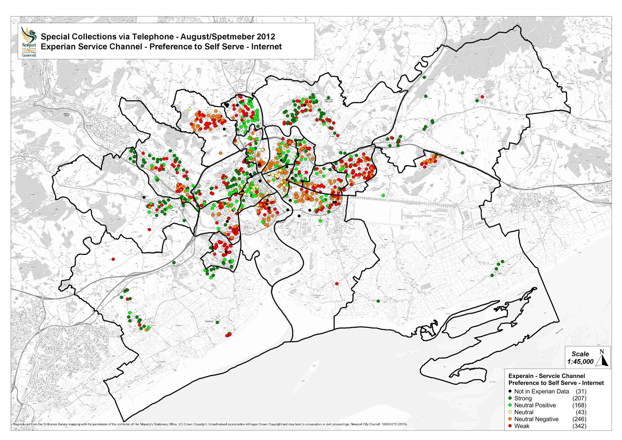
Notes:
Here’s another example of how our GIS team were able to combine data from various sources and map it. Every dot on that map shows a customer who booked a bulky item collection last August or September. The colour coding shows how likely these customers would be to use online services.
This is allowing to do a letter drop to the green dots where we suspect that people may just not be aware of the services which are available online

Slide 12
Legacy Technology
Out of date CMS
Adobe Coldfusion
Notes:
We were starting to get a really good picture of how people were, and weren’t, using our website. One of the big challenges now was in the technology we had behind the scenes.
Our CMS is outdated, we still use Coldfusion if anyone remembers that?
Unfortunately, the CMS replacement isn’t due until next year, but we also knew that we needed to do something to meet our channel shift targets

Slide 13
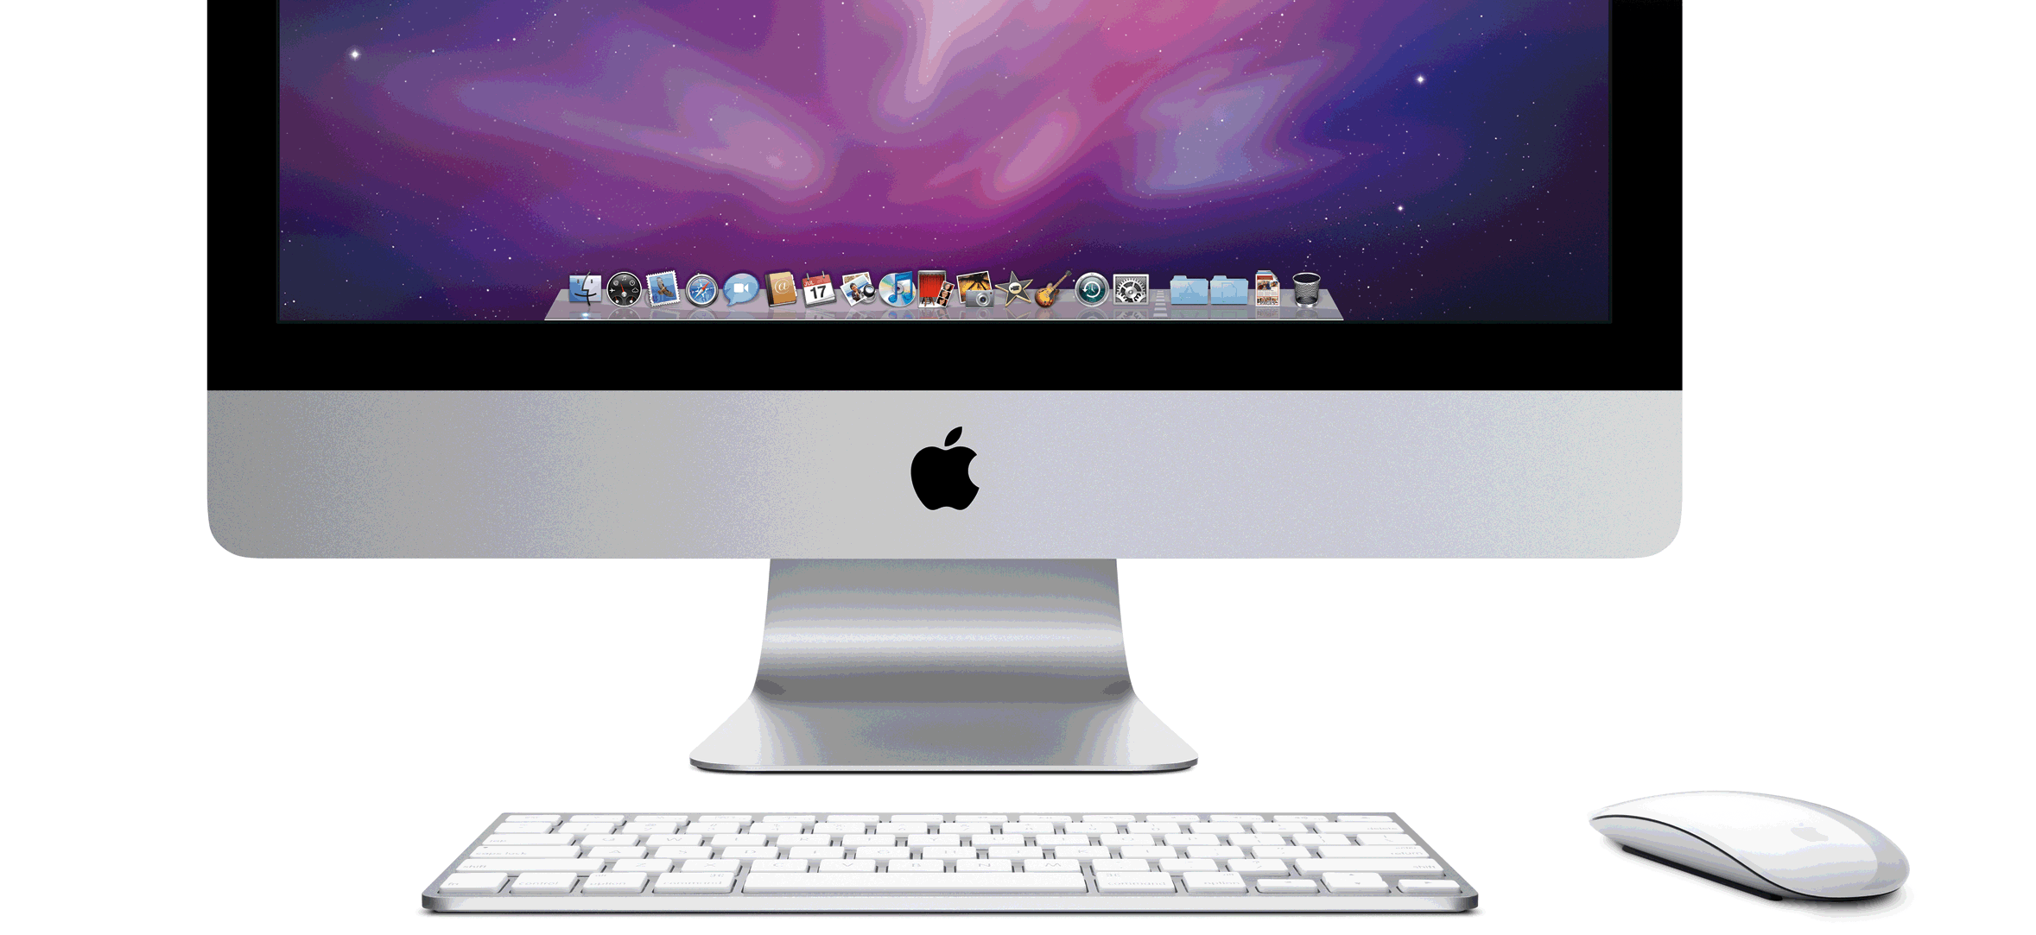
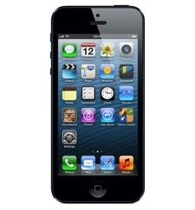
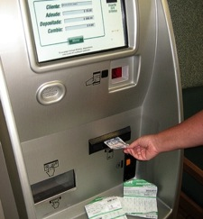
Areas to Target

Slide 14
New Design
Notes:
Working with Sequence, we came up with a much cleaner looking identity for the site
A lot more space allocated to top tasks and local info, space allocated to promoting our social media channels

Slide 15
Reduce Content
Before
Now
Notes:
Took some of the key pages and moved away from the “text article” which every page was being treated as
We’re now moving towards having our second level, and some third level, pages in this new format which gives quick access to the most popular services

Slide 16
Go Mobile
Do nothing
Native apps
Dedicated mobile site
Responsive web
Notes:
We’re fast approaching seeing half our visits coming from mobile devices now.
We looked at the options we had. The first was to do nothing, and for a while this was actually our preferred option.
We knew the site “worked” on mobile devices, it just wasn’t particularly nice to use.
We also looked at native apps. It seems that everyone needs an app these days. The thing is, you don’t just need one app, you need 2, maybe 3 if you want to include Windows phone. Then if Ubuntu Mobile takes off, or Firefox mobile OS, or blackberry see’s a resurgence… That’s before you get into maintaining it. Apple release a phone with a bigger screen, rework your app. And that’s without even getting into the fragmentation across Android devices.
We have experiemented before with dedicated mobile sites, often offering cut down features and content based on what we thought people would actually want to do on the move. These days though, we’re seeing people sat on their sofas with a smartphone or tablet, and more and more people who only have a smartphone rather than a traditional PC or laptop
So we decided on going with a responsive site.
A responsive site is basically one where you offer exactly the same site up to all devices, but the site detects the size of the screen it’s on and rearranges the page to suit

Slide 17
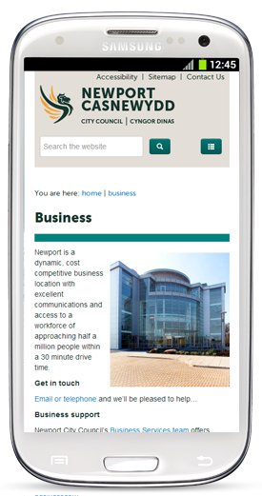
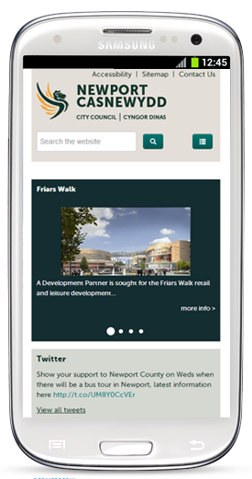
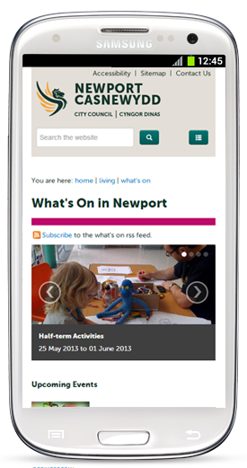
Going Mobile

Slide 18
Bringing Everything Together
Our “site” is actually many sites
“Main website” – Coldfusion / Stellent
Online forms – Jadu xForms
Library services – LION
Local information (maps etc) – Astun Ishare
Jobs - ITrent
Notes:
One of the other challenges we face is that, as more and more is expected from our website, we’ve procured 3rd party software from all these different vendors.
Generally the software works well enough, but it doesn’t always offer the best solution for the customer

Slide 19
Checking Your Bin Day
Homepage
Search / A-Z / Menu (Community, Living & Leisure)
Then Waste & Recycling
Then find the text link “Find out your bin day”
Off to Astun Ishare (My Newport)
Enter your postcode

Slide 20
…continued
Choose your address from the list
Go to the “My House” page
Scroll through Council tax bands, your councillors, nearest planning apps…
Find your bin day!

Slide 21
Integrating
Look for ways to hook into the data from other applications
REST, SOAP, Stored Procedures
Notes:
One of the key things we’ve started to introduce is to pull the resources together logically

Slide 22
Now…
Homepage
Waste & Recycling link from Top Tasks
Enter your postcode
Choose your address
Done!

Slide 23
Where We Are Now

Slide 24
So far…
46%
Of all transactions now completed via Self Service
Notes:
As of May 2013, over 46% of transactions are now completed via self service

Slide 25
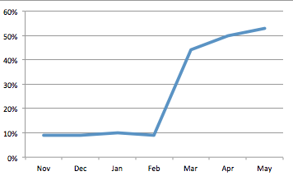
Success Story – Parking Fines
Reworded the “Payment Information” on the parking fines to promote “Online”
Immediate impact, now 63% paid online
Notes:
Technology is only part of the answer in moving towards self service channels
We often found that the simplest (and cheapest) things were the most effective
Changing the wording on the parking fines had a more noticeable impact than the “bigger stuff”

Slide 26
What’s Next?
More integrations – report a pothole via a map…
Replacement CMS
Super Connected Cities
Forced channel shift
Tackle digital exclusion

Slide 27
Thank You
Questions?
Matthew Peters
Email: matthew.peters@newport.gov.uk

